Slide 1

Distributing Apache Airflow
Notes:
https://courses.cs.washington.edu/courses/cse403/13au/lectures/git.ppt.pdf
http://enos.itcollege.ee/~jpoial/allalaadimised/git/getting-started-with-git.pdf

Slide 2
Introduction

Slide 3
An Overview
Sequential Executor with SQLite
Local Executor with Postgres
Set up a cluster with Celery Executor and Docker
Distributing your tasks with the Celery Executor
How to specialize your workers
How to limit task executions with Pools
Scaling Airflow with Kubernetes Executors
Set up a 3 nodes cluster with Kubernetes, Rancher and Vagrant
And more …..

Slide 4
Sequential Executor with SQLite
The most basic settings

Slide 5
What is SQLite?
Relational Database
Not a client-server, embedded into the end program ACID compliant
Implement most of the SQL Standard
Almost no configuration to run
Unlimited number of readers
Only one writer at any instant in time
Limited in size up to 140 TB
Database stored into a single disk file

Slide 6
How a task gets executed?
When a DAG is scheduled, each task has a record with its status (queued, scheduled, running, success, failed) stored into the metadata database.
The Scheduler periodically reads from the metadata database to check if there is any task to run.
The Executor gets the tasks to run from its internal queue and specify how to execute it (Sequential, Local, Celery, K8s)

Slide 7
What is the Sequential Executor?
Most basic executor
Only run one task at a time
Only executor to use with SQLite
Default configuration
Should not be used in production, only for debugging purposes in the context of Airflow

Slide 8
Parameters
In airfiow.cfg
executor=SequentialExecutor
sql_alchemy_conn=sqlite:////home/airflow/airflow/airflow.db

Slide 9
Local Executor with PostgreSQL

Slide 10
What is the Local Executor?
Run multiple tasks in parallel
Base on the python module: multiprocessing Spawn processes to execute tasks
Easy to set up
Resource light
Vertical Scaling
Single point of failure
As a best practice, always try the Local Executor first! KISS (Keep it simple, stupid)

Slide 11
What is PostgreSQL?
Object relational database
ACID compliant
Client-server database
Handle concurrent connections
SQL standard and advanced
Highly scalable
Extensible

Slide 12
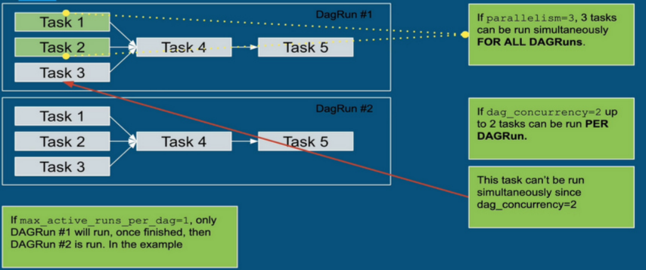
Concurrency and parallelism parameters

Slide 13
Local Executor strategies
parallelism = 0
"Unlimited" parallelism
parallelism > 0
Limited parallelism
As a best practice, set parallelism to:
number_of_cores - 1

Slide 14
Scale out Apache Airflow with Celery Executors
Distributed mode

Slide 15
What is the Celery Executor?
Scale out Apache Airflow
Backed by Celery: Asynchronous Distributed Task Queue
Distribute tasks among worker nodes
airflow worker: Create a worker to execute tasks
Horizontal Scaling
High availability: If one worker goes down, Airflow can still schedule tasks
Need a message broker: RabbitMQ/Redis
Can set different queues

Slide 16
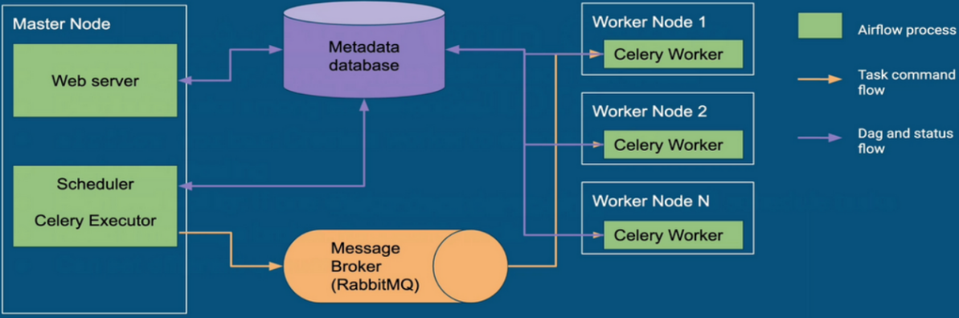
What is the Celery Executor?

Slide 17
What are the drawbacks?
Need an extra component: Message Broker Service
Take time and work to set up
Worker maintenance

Slide 18
Reminder about Kubernetes
Before using the Kubernetes executors

Slide 19
Kubernetes is extremely powerful
Open source project founded by Google in 2014.
Container orchestrator
Kubernetes automates sysadmin tasks:
Upgrading servers, installing security patches, configuring neworks, running backups, failover, monitoring
Zero-downtime deployments with rolling updates
Provides facilities to implement CD practices: Canary / Blue-green
Supports autoscaling (up and down)
Redundancy and failover built in, applications more reliable and resilient
And more...

Slide 20
… but has some gotchas
Setting up correctly a K83 is a real pain.
Hard to maintain.
The learning curve is steep.

Slide 21
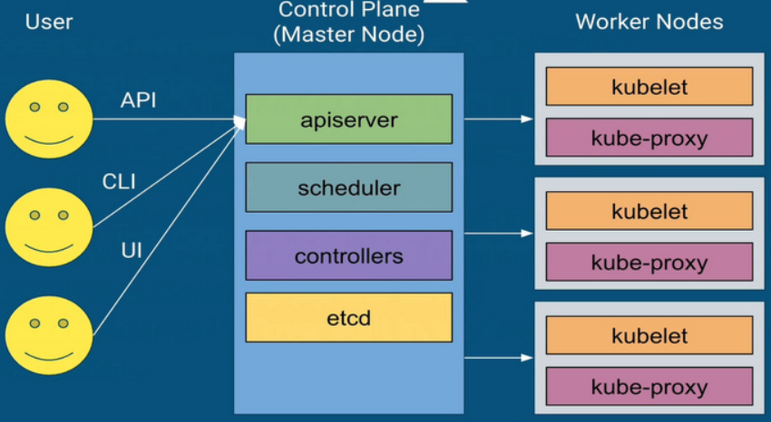
Cluster Architecture

Slide 22
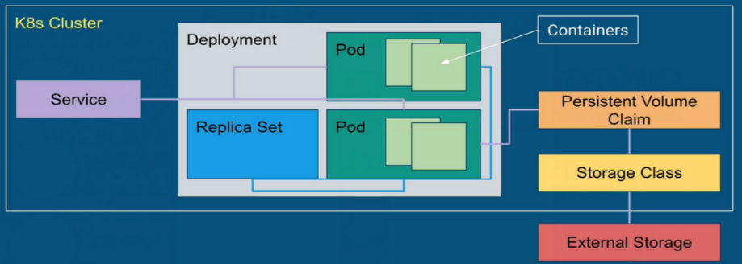
Important Kubernetes objects

Slide 23
Important Kubernetes objects
Pod
Group of one or more containers
Replica Set
Ensures that a specified number of pod replicas are running at any given time.
Service
Defines a logical set of Pods and a policy by which to access them.
Storage class
Provides a way to describe a "class” of storage. Represents a Persistent Volume.
Persistent Volume Claim
Abstraction of Persistent Volumes. A Persistent volume is a piece of storage in the cluster

Slide 24
Scaling Airflow with Kubernetes Executors
The next level

Slide 25
Drawbacks of the Celery Executor
Need to set up tier applications (RabbitMQ, Celery, Flower)
Deal with missing dependencies
Wasting resources: airflow workers stay idle when no workload
Worker nodes are not as resilient as you think
Nonetheless, it stays a widely used executor in production

Slide 26
What is the Kubernetes Executor?
Runs your tasks on Kubernetes
One task = One Pod
Task-level Pod configuration
Expands and shrinks your cluster according to the workload
Pods run to completion
Scheduler subscribes to Kubernetes event stream
DAG distribution
Git clone with init-container for each Pod
Mount volume with DAGs
Build image with the DAG codes

Slide 27
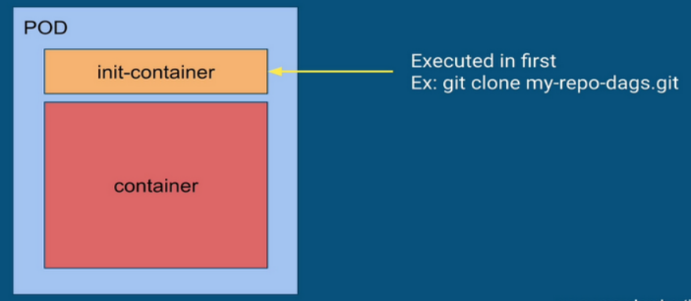
What is the Kubernetes Executor?
Git clone with init-container for each Pod

Slide 28
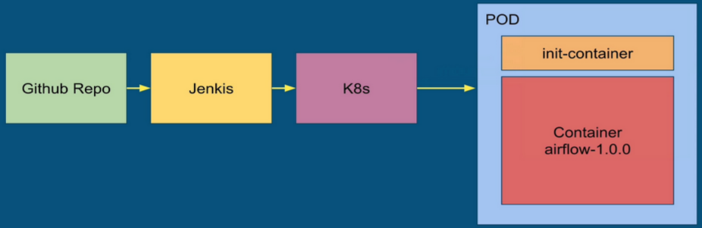
What is the Kubernetes Executor?
Cl/CD pipeline with Airflow image containing DAGs

Slide 29
What are the drawbacks?
Kubernetes is hard
Still new

Slide 30
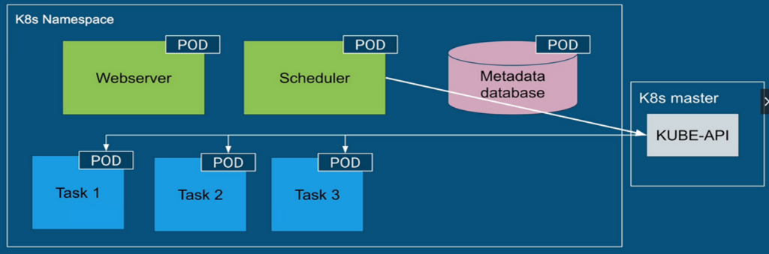
What is the Kubernetes Executor?

Slide 31
Thanks

